Slide 1
Predicting Diabetes from Telephone Interviews
Joe Hardin
Introduction to Machine Learning: Supervised Learning
University of Colorado – Boulder

Slide 2
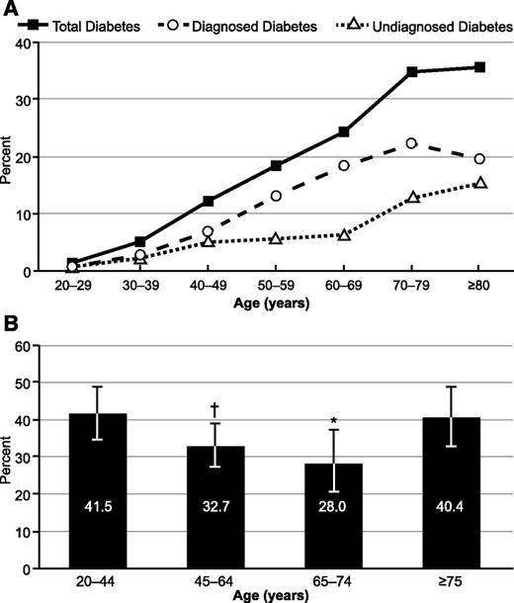
What is Diabetes
Diabetes is due to either the pancreas not producing enough insulin, or the cells of the body not responding properly to the insulin produced - Wikipedia
In 2019, diabetes resulted in approximately 4.2 million deaths. It is the 7th leading cause of death globally. - Wikipedia
Learning about the disease and actively participating in the treatment is important, since complications are far less common and less severe in people who have well-managed blood sugar levels. - Wikipedia
https://en.wikipedia.org/wiki/Diabetes
Graph source: https://diabetesjournals.org/care/article/42/6/994/35979/Diabetes-Diagnosis-and-Control-Missed

Slide 3
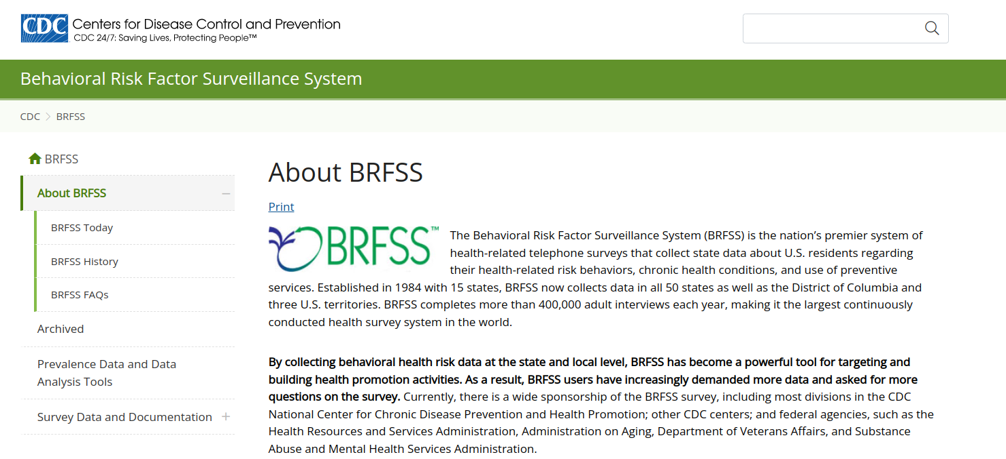
BRFSS
Screenshot from: https://www.cdc.gov/brfss/about/index.htm

Slide 4
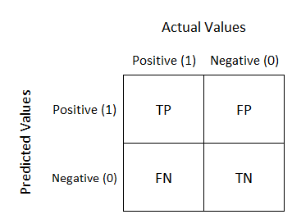
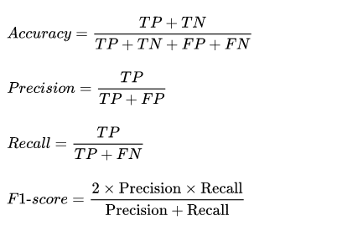
Purpose
Can we identify individuals at high risk for having diabetes from the answers given in the BRFSS?
https://towardsdatascience.com/understanding-confusion-matrix-a9ad42dcfd62
https://www.tutorialexample.com/an-introduction-to-accuracy-precision-recall-f1-score-in-machine-learning-machine-learning-tutorial/

Slide 5
BRFSS Continued
2015 Phone Script can be found here : https://www.cdc.gov/brfss/questionnaires/pdf-ques/2015-brfss-questionnaire-12-29-14.pdf
Potential sources of bias:
  Only interviewed people with landlines in their residence (potential to bias by age, housing security, other factors)
  Only conducted in English (may under count certain populations in the USA)
  Methodology selects for people who answer unknown numbers and have the time to answer 20-58 questions (less clear if this sub population is more prevalent in some groups compared to others)
  People’s perception of the truth, not necessarily an objective TRUTH

Slide 6
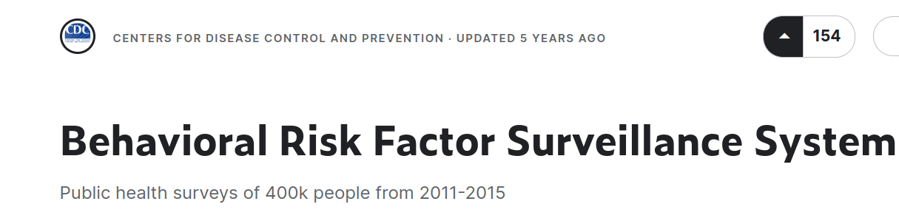
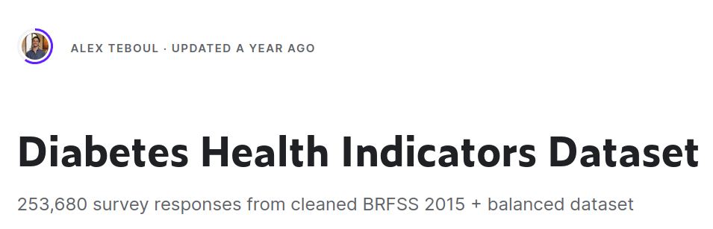
Data Exploration
CDC’s BRFSS – Original Source
https://www.cdc.gov/brfss/about/index.htm
Full Dataset uploaded by the CDC to Kaggle
Alex Teboul put uploaded a clean dataset with all the responders in 2015 who answered all core questions to Kaggle

Slide 7
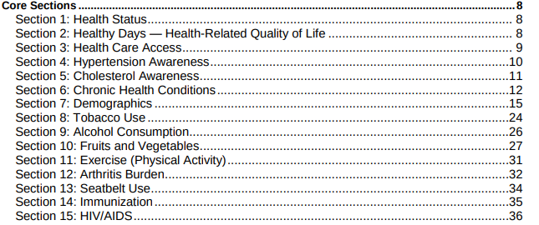
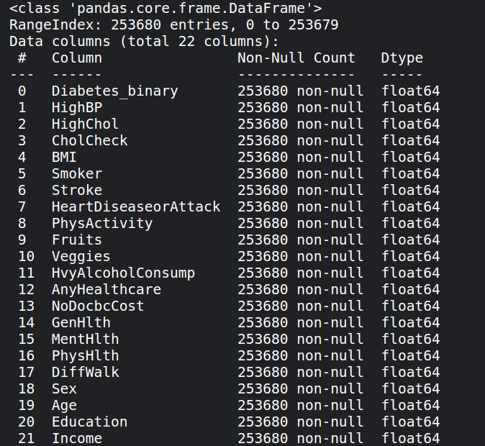
Data Exploration Continued
y:Binary(#0)
X : 21 features (#1-21)

Slide 8
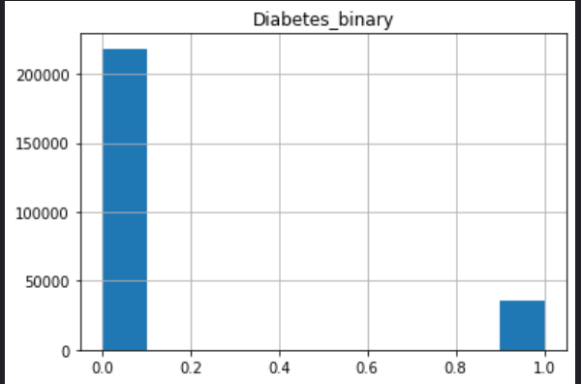
Data Exploration Continued
Unbalanced Data
0 – Non Diabetic
1 – Prediabetic/Diabetic
BFRSS was trinary
1

Slide 9
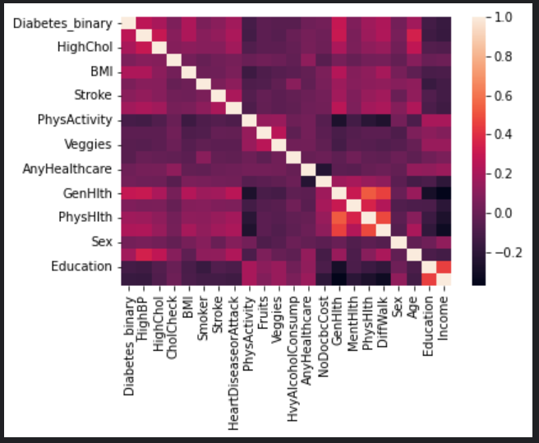
Data Exploration Continued

Slide 10
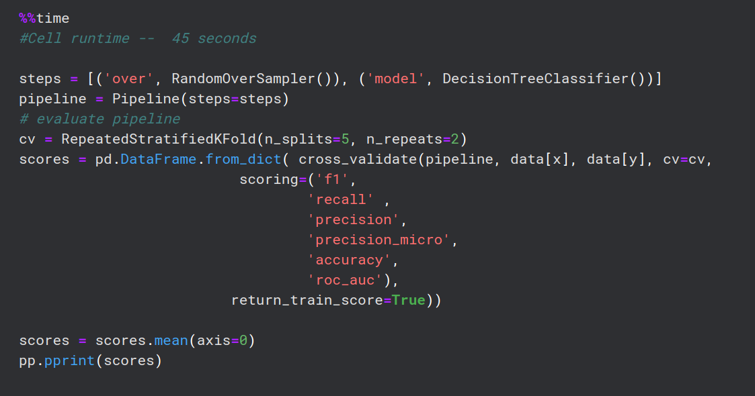
Supervised Machine Learning Methodology

Slide 11
Logistic Regression
 | Unbalanced | With Oversampling
F1 Score – Train | 0.242 | 0.433
F1 Score – Test | 0.241 | 0.433
Recall Score – Train | 0.156 | 0.766
Recall Score – Test | 0.156 | 0.766
Precision Score – Train | 0.536 | 0.312
Precision Score – Test | 0.535 | 0.311
Accuracy Score – Train | 0.864 | 0.732
Accuracy Score – Test | 0.863 | 0.732
ROC_AUC – Train | 0.822 | 0.823
ROC_AUC – Test | 0.822 | 0.823
Oversampling Increased Recall decreased Precision
Both Unbalanced and Oversampled data were scaled before model was trained.

Slide 12
Single Decision Tree
 | Unbalanced | With Oversampling
F1 Score – Train | 0.979 | 0.971
F1 Score – Test | 0.307 | 0.291
Recall Score – Train | 0.960 | 0.997
Recall Score – Test | 0.323 | 0.298
Precision Score – Train | 0.999 | 0.946
Precision Score – Test | 0.293 | 0.285
Accuracy Score – Train | 0.994 | 0.992
Accuracy Score – Test | 0.797 | 0.798
ROC_AUC – Train | 0.999 | 0.999
ROC_AUC – Test | 0.598 | 0.589
Clearly Overfit – Further Tuning Required

Slide 13
Random Forest
 | Unbalanced | With Oversampling
F1 Score – Train | 0.979 | 0.97
F1 Score – Test | 0.254 | 0.352
Recall Score – Train | 0.964 | 0.997
Recall Score – Test | 0.173 | 0.307
Precision Score – Train | 0.995 | 0.944
Precision Score – Test | 0.487 | 0.412
Accuracy Score – Train | 0.994 | 0.991
Accuracy Score – Test | 0.859 | 0.842
ROC_AUC – Train | 0.999 | 0.999
ROC_AUC – Test | 0.798 | 0.793
Clearly Overfit – Further Tuning Required

Slide 14
AdaBoost
 | Unbalanced | With Oversampling
F1 Score – Train | 0.28 | 0.445
F1 Score – Test | 0.279 | 0.445
Recall Score – Train | 0.188 | 0.772
Recall Score – Test | 0.187 | 0.771
Precision Score – Train | 0.547 | 0.313
Precision Score – Test | 0.544 | 0.313
Accuracy Score – Train | 0.865 | 0.732
Accuracy Score – Test | 0.865 | 0.732
ROC_AUC – Train | 0.827 | 0.827
ROC_AUC – Test | 0.826 | 0.826

Slide 15
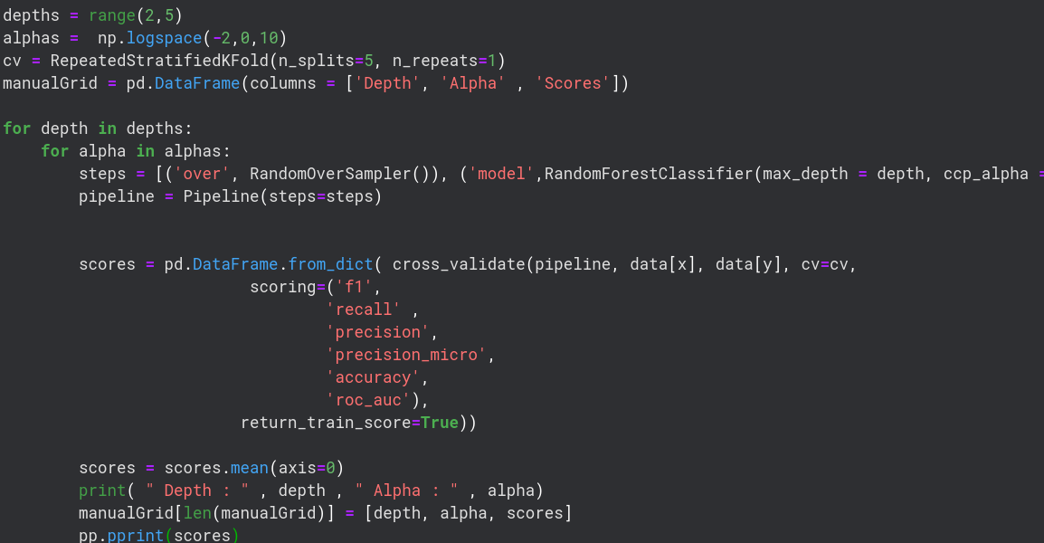
Tuning Random Forest Model

Slide 16
Random Forest – Revisited
 | Unbalanced | With Oversampling | Oversampling Tuning
F1 Score – Train | 0.979 | 0.97 | 0.423
F1 Score – Test | 0.254 | 0.352 | 0.423
Recall Score – Train | 0.964 | 0.997 | 0.757
Recall Score – Test | 0.173 | 0.307 | 0.756
Precision Score – Train | 0.995 | 0.944 | 0.294
Precision Score – Test | 0.487 | 0.412 | 0.293
Accuracy Score – Train | 0.994 | 0.991 | 0.713
Accuracy Score – Test | 0.859 | 0.842 | 0.712
ROC_AUC – Train | 0.999 | 0.999 | 0.803
ROC_AUC – Test | 0.798 | 0.793 | 0.802

Slide 17
Conclusion
Can we identify individuals at high risk for having diabetes from the answers given in the BRFSS?
The best model tried (Adaboost with Oversampling) give the below results (cv=3)
Depends on Stakeholder feedback
27,240
59820
8,106
158,514

